Slide 1

Kingpin Bowling Tracker
By: Darius Grasseschi, Evan Hassan, Jonathan Lacoursiere, Ariana Lee, Maria Medina, and Cody Trombley

Slide 2
Functional Requirements (Sprint 1)
FR1. Users shall be able to create an accounts within the system.
FR2. Users shall be able to log into the system with proper account credentials.
FR3. Users shall be able to update password in system.
FR4. Users shall be able to log out of the system.
FR5. Bowling Center Managers shall be able to manage user accounts.

Slide 3
Functional Requirements (Sprint 2)
FR6. BCM shall be able to create a League in the system.
FR7. BCM shall be able to modify a league.
FR8. BCM shall be able to delete a league.
FR9. Each league shall allow specific league rules to be customized upon
creation.

Slide 4
User Stories
Req. Num. | User Story | Use Case
FR.1 | As a User, I would like to be able to create an account in the system so that I can use the application. | UC1
FR.2 | As a User, I would like to be able to log into the system to access restricted application resources. | UC2
FR.3 | As a User, I would like to be able to change my password to maintain account security. | UC3
FR.4 | As a User, I would like to be able to log out of the system when I am done accessing resources. | UC4
FR.5 | As an Administrator, I would like to be able to access the applications administration panel for providing site management. | UC5
FR.6 | As a Bowling Center Manager, I would like to be able to create leagues to manage league duties | UC6

Slide 5
Risks and Challenges
Poor communication
Different schedules among group members makes communication difficult
Poor time management among members of the group
Learning curve of working with new platforms that some of us aren’t very experienced in
Django Rest Framework, custom user permissions
Equitable distribution of project workload

Slide 6
Mitigation Plan
Plans to mitigate our risks include:
Regular team meetings and project status updates
Separation of member responsibilities to allow more focus on separate parts of project
Use of a project management tool, such as Microsoft Project or Project Libre, to keep track of time
Lots of time studying the Django documentation

Slide 7
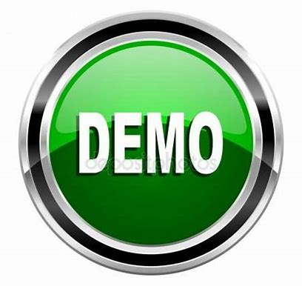

Slide 8
Next Sprint Objectives
Sprint 2 Functional Requirements
Begin creating Groups and Permissions in Django
Need different custom permission levels for Bowling Center Managers, for League Secretaries, and for Bowlers
UI Development
Django Rest Framework exploration
Create initial set of Models
Creation of Leagues, including customizable Rulesets
Team creation
Bowler Database
Documentation
Class diagram, Entity-relationship diagram
Use Cases/User Stories

Slide 9
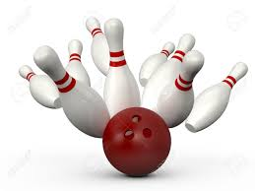

THANK YOU
Any Questions?

